Slide 1
CS2005 Database Systems
Fall 2022
National University of Computer and Emerging Sciences

Slide 2
CHAPTER 2
Database System Concepts and Architecture

Slide 3
Data Models
Data Model:
A set of concepts to describe the structure of a database, the operations for manipulating these structures, and certain constraints that the database should obey.
Data Model Structure and Constraints:
Constructs are used to define the database structure
Constructs typically include elements (and their data types) as well as groups of elements (e.g. entity, record, table), and relationships among such groups
Constraints specify some restrictions on valid data; these constraints must be enforced at all times
Notes:
An entity represents a real-world object or concept, such as an employee or a project from the miniworld that is described in the database.
An attribute represents some property of interest that further describes an entity, such as the employee’s name or salary.
A relationship among two or more entities represents an association among the entities

Slide 4
Data Models (continued)
Data Model Operations:
These operations are used for specifying database retrievals and updates
Operations on the data model may include basic model operations (e.g. generic insert, delete, update) and user-defined operations (e.g. compute_student_gpa, update_inventory)

Slide 5
Categories of Data Models
Conceptual (high-level, semantic) data models:
Provide concepts that are close to the way many users perceive data.
(Also called entity-based or object-based data models.)
Physical (low-level, internal) data models:
Provide concepts that describe details of how data is stored in the computer. These are usually specified in an ad-hoc manner through DBMS design and administration manuals
Implementation (representational) data models:
Provide concepts that fall between the above two, used by many commercial DBMS implementations (e.g. relational data models used in many commercial systems).
Self-Describing Data Models:
Combine the description of data with the data values. Examples include XML, key-value stores and some NOSQL systems.

Slide 6
Schemas versus Instances
Database Schema:
The description of a database.
Includes descriptions of the database structure, data types, and the constraints on the database.
Schema Diagram:
An illustrative display of (most aspects of) a database schema.
Schema Construct:
A component of the schema or an object within the schema, e.g., STUDENT, COURSE.

Slide 7
Schemas versus Instances
Database State:
The actual data stored in a database at a particular moment in time. This includes the collection of all the data in the database.
Also called database instance (or occurrence or snapshot).
The term instance is also applied to individual database components, e.g. record instance, table instance, entity instance

Slide 8
Database Schema vs. Database State
Database State:
Refers to the content of a database at a moment in time.
Initial Database State:
Refers to the database state when it is initially loaded into the system.
Valid State:
A state that satisfies the structure and constraints of the database.

Slide 9
Database Schema vs. Database State (continued)
Distinction
The database schema changes very infrequently.
The database state changes every time the database is updated.
Schema is also called intension.
State is also called extension.

Slide 10
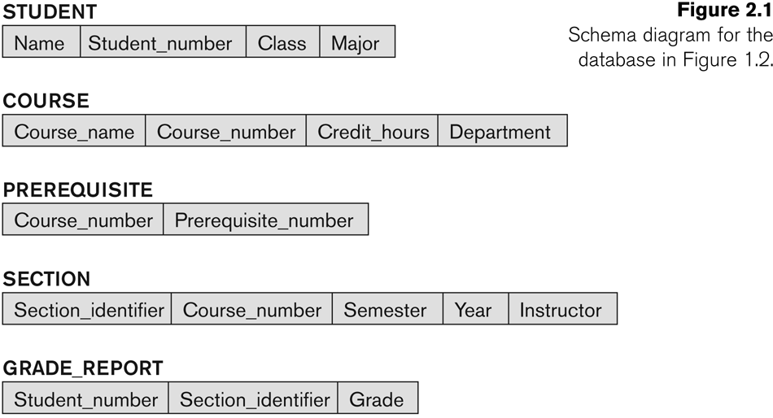
Example of a Database Schema

Slide 11
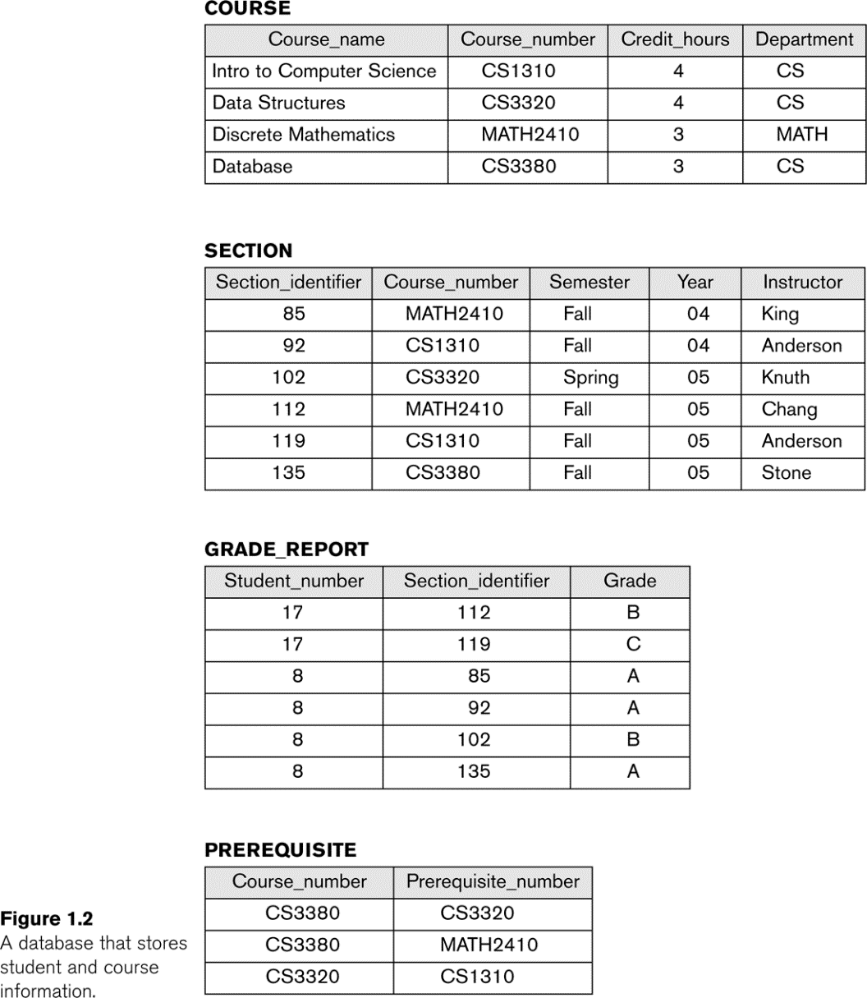
Example of a Database State

Slide 12
Three-Schema Architecture
Defines DBMS schemas at three levels:
Internal schema at the internal level to describe physical storage structures and access paths (e.g. indexes).
Typically uses a physical data model.
Conceptual schema at the conceptual level to describe the structure and constraints for the whole database for a community of users.
Uses a conceptual or an implementation data model.
External schemas at the external level to describe the various user views.
Usually uses the same data model as the conceptual schema.
Notes:
The three schema architecture is also used to separate the user applications and physical database.
Physical schema describes how data is to be represented and stored (files, indices, et al.) in secondary storage using a particular database management system (DBMS) (e.g., Oracle RDBMS, Sybase SQL Server, etc.).
The logical schema was the way data were represented to conform to the constraints of a particular approach to database management

Slide 13
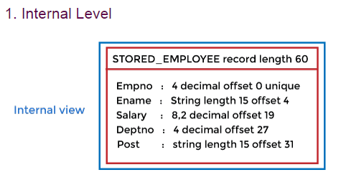
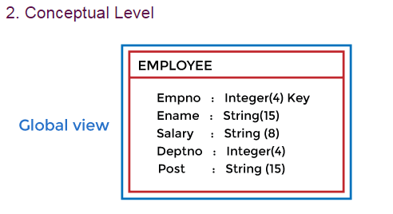
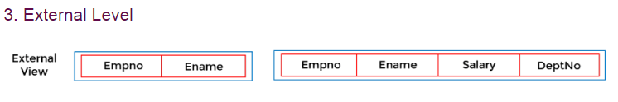

Slide 14
Three-Schema Architecture
Proposed to support DBMS characteristics of:
Program-data independence.
Support of multiple views of the data.
Not explicitly used in commercial DBMS products, but has been useful in explaining database system organization

Slide 15
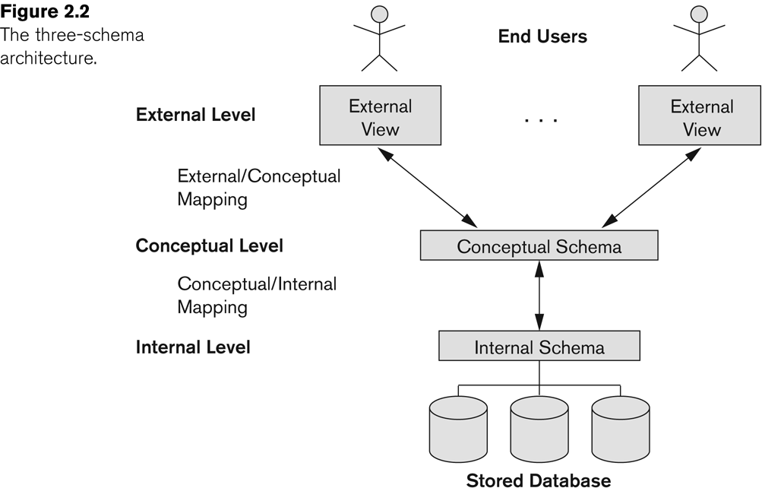
The three-schema architecture

Slide 16
Three-Schema Architecture
Mappings among schema levels are needed to transform requests and data.
Programs refer to an external schema, and are mapped by the DBMS to the internal schema for execution.
Data extracted from the internal DBMS level is reformatted to match the user’s external view (e.g. formatting the results of an SQL query for display in a Web page)

Slide 17
Data Independence (continued)
When a schema at a lower level is changed, only the mappings between this schema and higher-level schemas need to be changed in a DBMS that fully supports data independence.
The higher-level schemas themselves are unchanged.
Hence, the application programs need not be changed since they refer to the external schemas.

Slide 18
DBMS Languages
Data Definition Language (DDL)
Data Manipulation Language (DML)
High-Level or Non-procedural Languages: These include the relational language SQL
May be used in a standalone way or may be embedded in a programming language
A high-level DML used in a standalone interactive manner is called a query language
Low Level or Procedural Languages:
These must be embedded in a programming language
It needs to use programming language constructs, such as looping, to retrieve and process each record from a set of records

Slide 19
DBMS Programming Language Interfaces
Programmer interfaces for embedding DML in a programming languages:
Embedded Approach: e.g embedded SQL (for C, C++, etc.), SQLJ (for Java)
Procedure Call Approach: e.g. JDBC for Java, ODBC (Open Databse Connectivity) for other programming languages as API’s (application programming interfaces)
Database Programming Language Approach: e.g. ORACLE has PL/SQL, a programming language based on SQL; language incorporates SQL and its data types as integral components
Scripting Languages: PHP (client-side scripting) and Python (server-side scripting) are used to write database programs.

Slide 20
DBMS Interfaces
Menu-based Interfaces for Web Clients or Browsing
Apps for Mobile Devices
Forms-based Interfaces
Graphical User Interfaces
Natural Language Interfaces
Keyword-based Database Search
Speech Input and Output
Interfaces for Parametric Users
Interfaces for Parametric Users

Slide 21
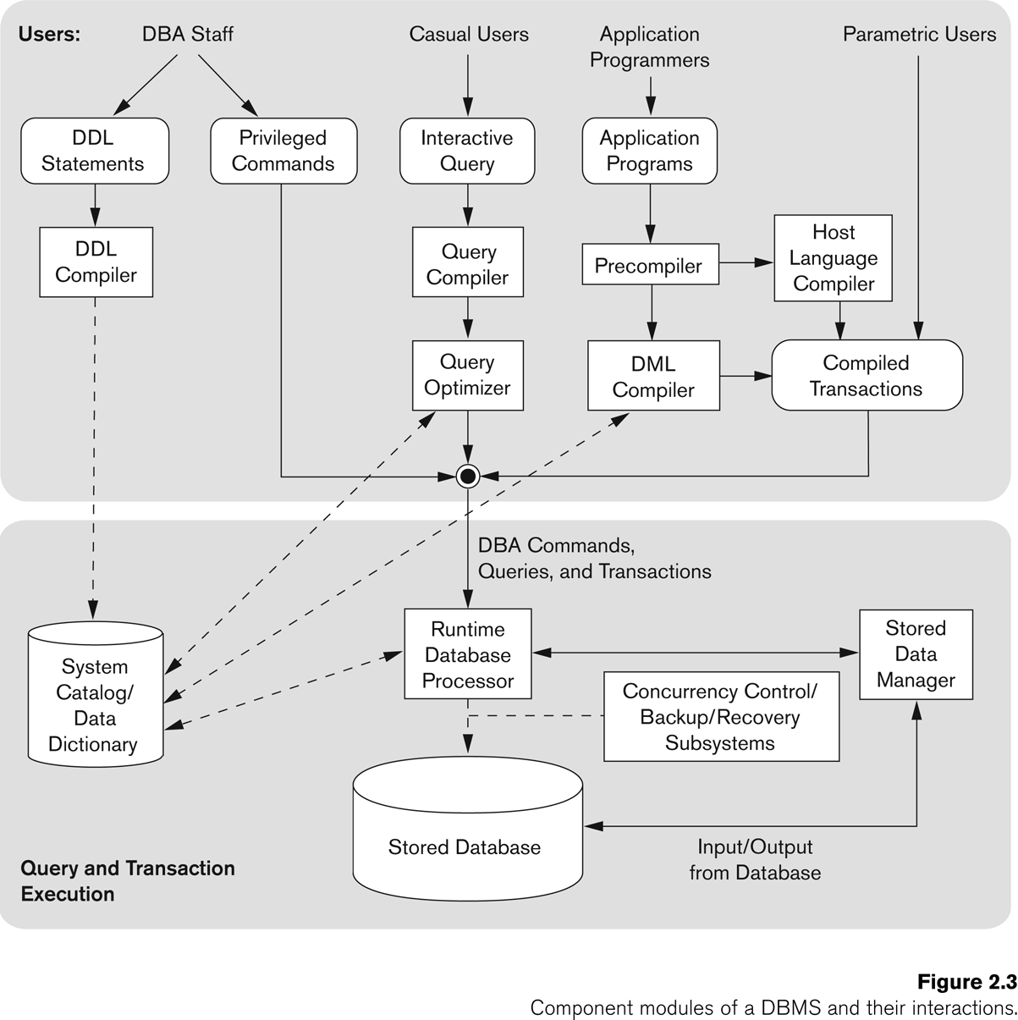
Typical DBMS Component Modules

